Slide 1
The Crime Detectives
Natasha
Jiffar
Kobe
Thierno

Slide 2
The NYPD arrested 210,000 persons in 2019
The following information is recorded with each arrest:
Type of Crime, Borough of Crime, Arresting Precinct , Age, Gender, and Race of the arrested
If the race of the person was no longer available to us, could we predict it using a model trained on past data?
Our result: (0.56 precision) (0.85 recall) (0.69 F1 score) for Black

Slide 3
We created the following classification models and trained and validated them:
Logistic Regression(Label Encoded and One-Hot Encoded;with and without PCA)
KNeighbours Classifier
Support Vector Machine
Decision Tree
Random Forest
Random Forest for Feature Importance then Random Forest

Slide 4
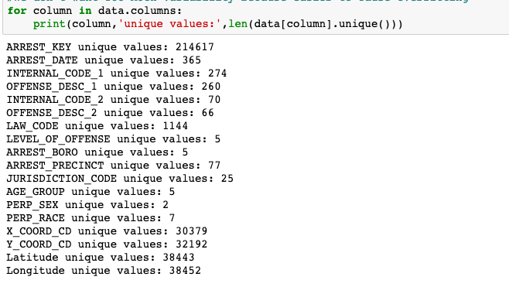
Within Column Variability (unique values)

Slide 5
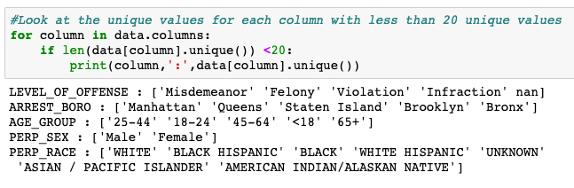
Within Column Variability (unique values) cont…

Slide 6
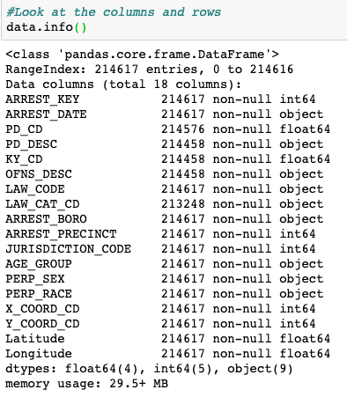
Even though we have numerical values in our dataset, our classification models will not use them as numbers, but rather will use them as categories because the numbers do not represent a measurement: they are simply IDs for internal office use.

Slide 7
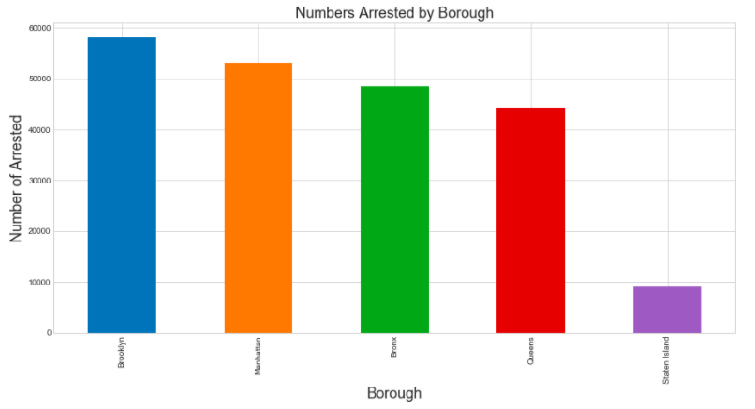
Arrests are spread out across the four Borough…

Slide 8
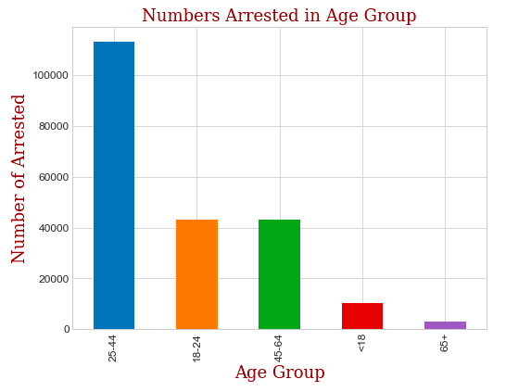
Persons between ages 25 – 44 make up a majority of arrested

Slide 9
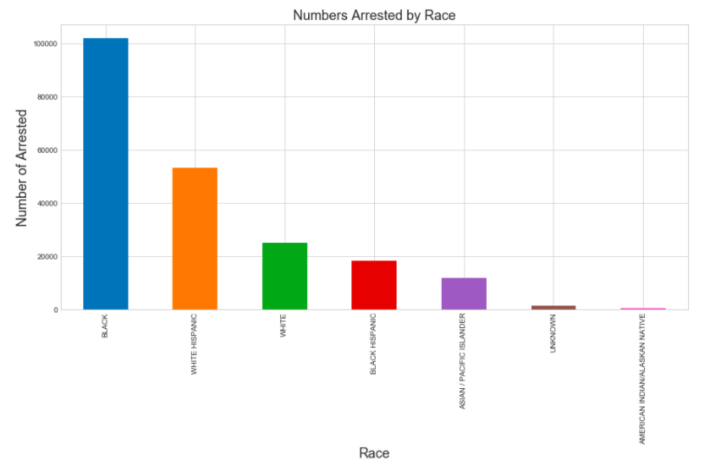
Persons who are black are more likely to be arrested

Slide 10
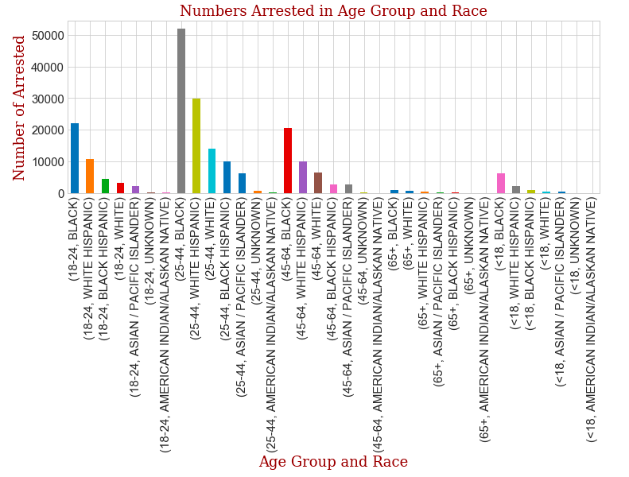
Persons who are black between 25-44 lead in the number of those arrested

Slide 11
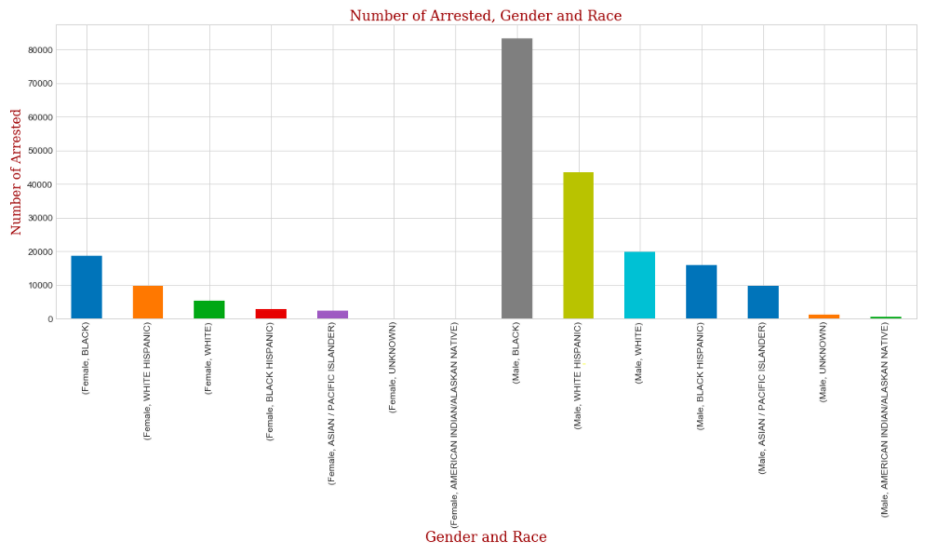
Males are arrested much more than females. Black males are arrested the most.

Slide 12
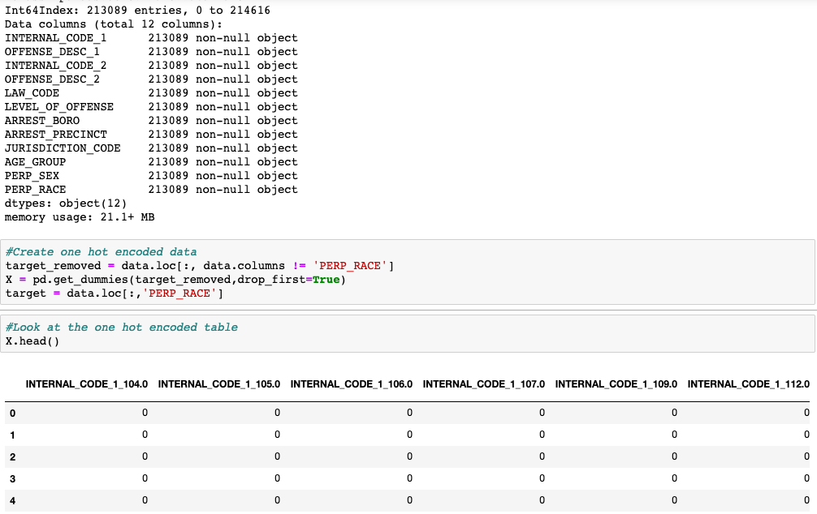
One Hot Encoding: Because the numeric columns contain internal NYPD codes and are not measurements, for our model every column is treated as nominal categorical for our classification (i.e: there is no ordering to the values)

Slide 13
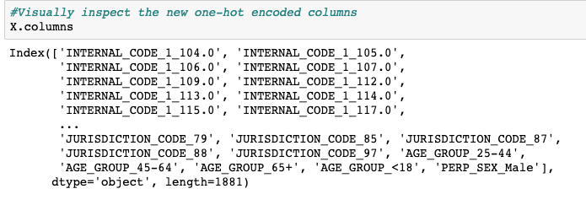
There is now 1,881 columns.
The one-hot-encoded dataframe columns

Slide 14
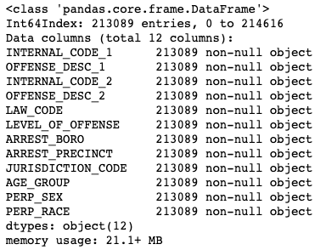
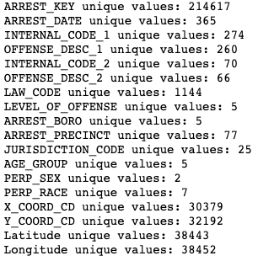
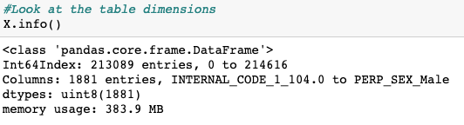
The cost of one hot encoding

Slide 15
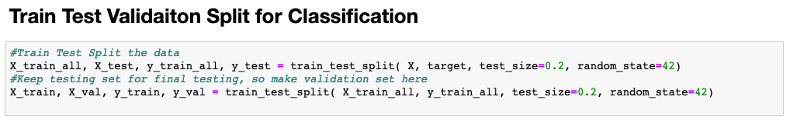
We used a validation and test split.

Slide 16
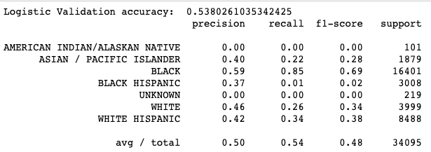
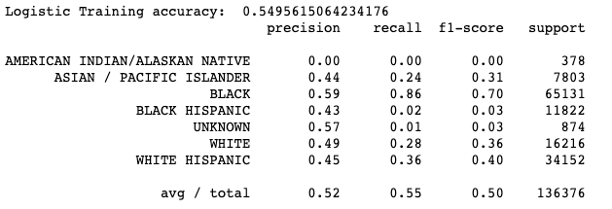
Logistic Regression without PCA

Slide 17
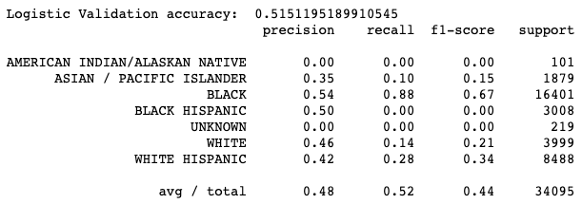
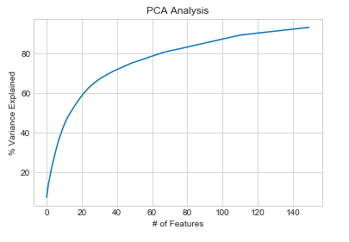
Logistic Regression with PCA

Slide 18
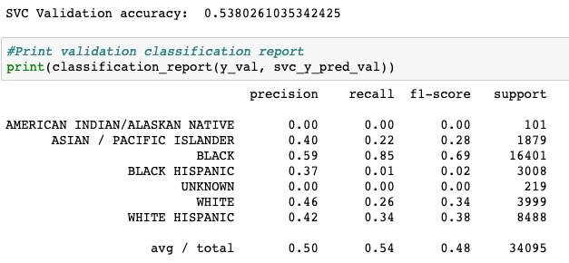
Support Vector Machine without PCA

Slide 19
KNeighbours
Took too long to train. Seems too many dimensions. Aborted

Slide 20
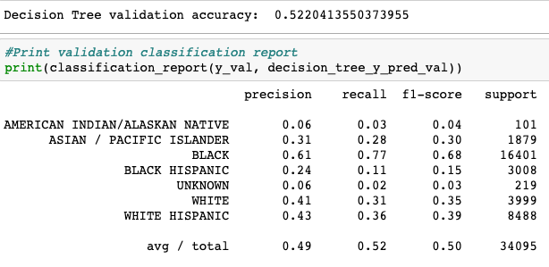
Decision Tree

Slide 21
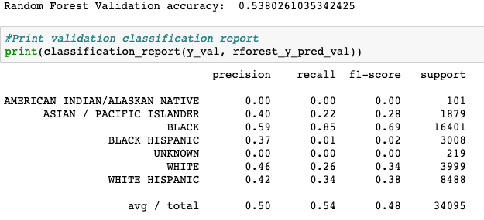
Random Forest

Slide 22
